Slide 1
Computer Modeling and Simulation
By
Sara Rehmat
MS(CS)

Slide 2
Random Walk
One technique of Monte Carlo simulations that has many applications in the sciences is the random walk.
Random walk refers to the apparently random movement of an entity.
Random walk refers to the movements of an object or changes in a variable that follow no discernible pattern or trend.

Slide 3
History of Random Walk – Brownian Motion
In 1827, Scottish botanist Robert Brown was studying pollen grains which he had mixed in water.
Although the water was absolutely still, the pollen grains seemed to quiver and move about randomly.
He could not stop the motion, or explain it.
He carefully described his observations in a paper.
When other researchers were able to reproduce the same behavior, even using other liquids and other particles, the phenomenon was named Brownian Motion, although no one had a good explanation for what they were observing.

Slide 4
History of Random Walk – Brownian Motion
In 1905, Albert Einstein wrote a paper explaining Brownian motion.
Each pollen grain, he said, was constantly being jostled by the motions of the water molecules on all sides of it.
Brownian motion also explained the phenomenon of diffusion, in which a drop of ink in water slowly expands and mixes.
As particles of ink randomly collide with water molecules, they spread and mix, without requiring any stirring.
The mixing obeys the √ T law, so that, roughly speaking, if the diameter of the ink drop doubles in 10 seconds, it will double again in 40 seconds.

Slide 5
Applications of Random Walk
In genetics, random walks have been used to simulate mutation of genes.
Scientists use the method polymerase chain reaction (PCR) to make many copies of particular pieces of DNA. A strand of DNA contains sequences of four bases, A, T, C, and G.
Using

Slide 6
Applications of Random Walk
Random walk theory suggests that changes in stock prices have the same distribution and are independent of each other.
Therefore, it assumes the past movement or trend of a stock price or market cannot be used to predict its future movement.
In short, random walk theory proclaims that stocks take a random and unpredictable path that makes all methods of predicting stock prices futile in the long run.
Though some financial experts don’t agree with this theory.

Slide 7
Applications of Random Walk
Biological movements at microscopic or macroscopic level
Google Search Engine Algorithms
Used in mathematics to calculate solutions to Laplace equations, harmonic measure etc
In wireless
In image segmentation, random walks are used to determine the labels (i.e., "object" or background") to associate with each pixel.
This algorithm is typically referred to as the random walker segmentation algorithm.
In wireless networking, a. random walk is used to model node movement.
On the web, the Twitter website uses random walks to make suggestions of whom to follow.

Slide 8
Random Walk - Stories
Lets start with a story about a captain whose ship was carrying a load of rum.
The ship was tied up at the dock, the captain was asleep, and the 100 sailors of the crew broke into the rum, got drunk, and staggered out onto the dock.
The dock was 100 yards long, and the ship was at the 50 yard mark.
The sailors were so drunk that each step they took was in a random direction, to the left or right.
They were only able to manage one step a minute.
Two hours later, the captain woke up. ”Oh no!” he said, ”There’s only 50 steps to the left or right and they fall into the sea! And two hours makes 120 steps!”
But he was surprised to see that 70 of the crew were actually within 12 steps to the left or right, and that all of the crew was alive and safe, though in sorry shape.

Slide 9
Random Walk - Stories
Mathematician George Polya would like to take morning walks in the woods and he noticed that he would bump regularly into the same couple.

Slide 10
Algorithm for Random Walk
At each time step of a particular random walk simulation, suppose an entity moves in a random, diagonal direction—NE, NW, SE, or SW.
To go in such a direction, the entity walks east or west one unit and north or south one unit, covering a diagonal distance of 2 units.
We develop a function, randomWalkPoints, with parameter, n, for the number of steps.
The function generates such a walk and returns a list or array of the coordinates of the steps.
In the function body, variables x and y store the horizontal and vertical coordinates, respectively, of the current location, and variable lst holds a list of locations in the path of the entity.
Because the walker starts at the origin, we initialize lst to be a list containing the point (0, 0). With parameter n being the number of steps to be taken, a loop to produce the path executes n times.

Slide 11
Algorithm for Random Walk
Within the loop, we generate one random integer of 0 or 1 to determine if the entity turns to the east or west by incrementing or decrementing x by 1, respectively. Then, another such “flip of the coin” dictates north with an increment of y or south with a decrement. We then append the new point (x, y) onto the developing lst.
After the loop at the end of the function, we return this list of points.

Slide 12
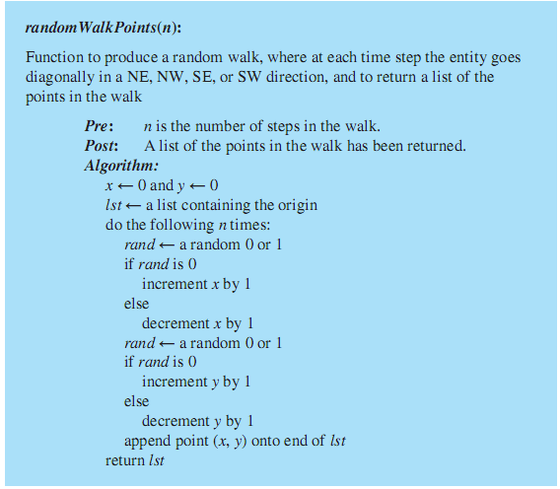

Slide 13
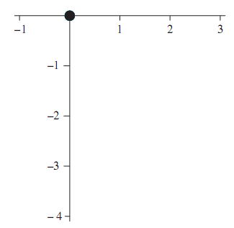
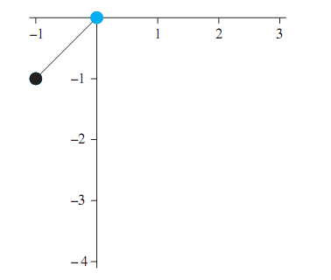
Random Walk

Slide 14
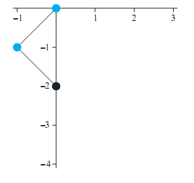
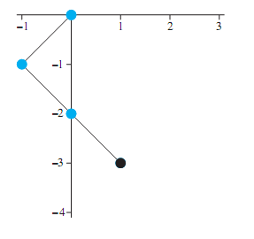
Random Walk

Slide 15
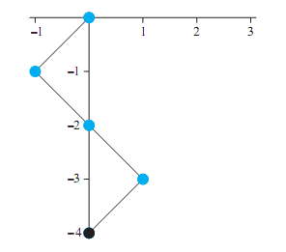
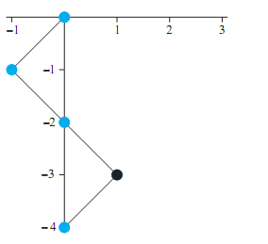
Random Walk

Slide 16
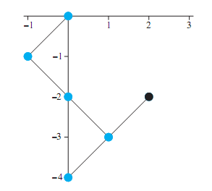
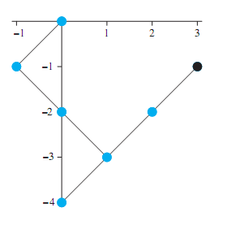
Random Walk

Slide 17
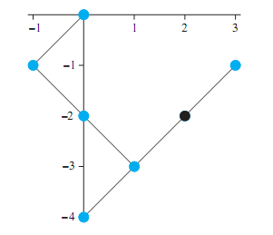
Notes:
<number>

Slide 18
MonteCarlo Simulation for average distance
To obtain an estimate of a typical distance between the starting and ending points of a random walk of n steps, we should run the simulation many times and take the average of all the distances.
In such a case, we are not interested in viewing a random walk, so we first defne another function, randomWalkDistance, that is similar to randomWalkPoints, but which returns the desired distance instead of the list of points in a walk.

Slide 19
MonteCarlo Simulation for average distance
For a function meanRandomWalkDistance, which returns the average distance traveled over numTests number of random walks of n steps each, we place a call to randomWalkPoints(n) in a loop that iterates numTests number of times.
A variable, numDist, accumulates the distances covered by the random walks.
Before the loop, numDist is initialized to zero; after the loop, this sum is divided by numTests to return the average distance.
One run of meanRandomWalkDistance

Slide 20
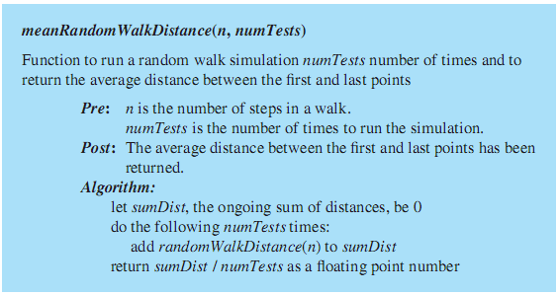
Average Distance Covered

Slide 21


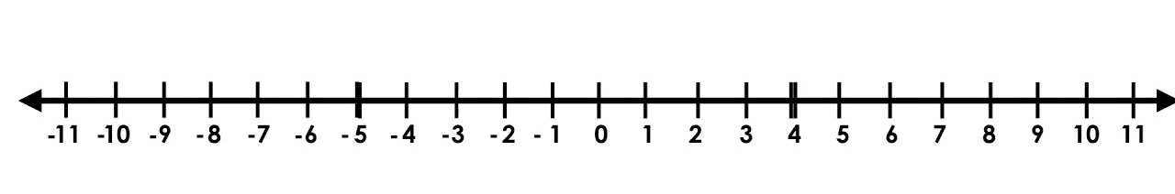
Random Walk along an Integer Line (1D Random Walk)
+1
-1
P(+1) = 1/2
P(-1) = 1/2

Slide 22
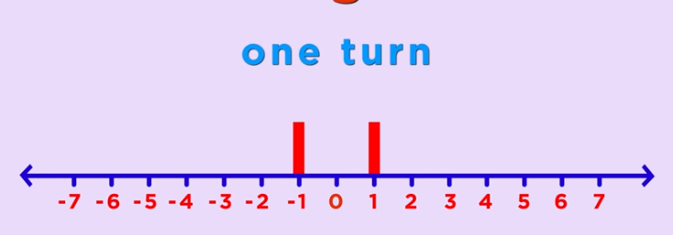
Random Walk along an Integer Line (1D Random Walk)
P(-1)=1/2
P(1)=1/2

Slide 23
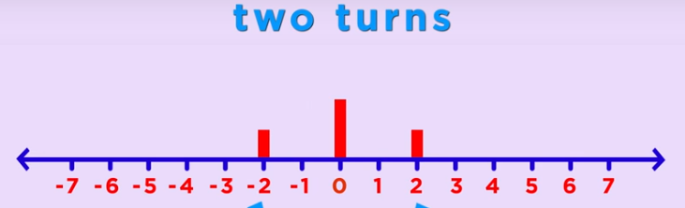
Random Walk along an Integer Line (1D Random Walk)
P(-2)=1/4
P(2)=1/4
P(0)=1/2

Slide 24
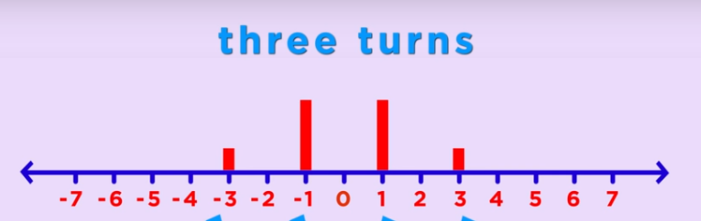
Random Walk along an Integer Line (1D Random Walk)

Slide 25
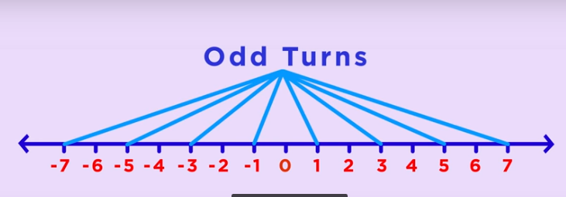
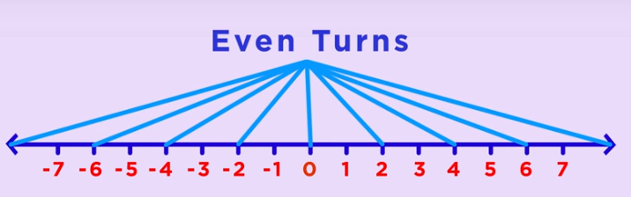
Random Walk along an Integer Line (1D Random Walk)

Slide 26
Probability at different points of integer line in successive coin flips
 | -8 | -7 | -6 | -5 | -4 | -3 | -2 | -1 | 0 | 1 | 2 | 3 | 4 | 5 | 6 | 7 | 8
1st |  |  |  |  |  |  |  | 1/2 |  | 1/2
2nd |  |  |  |  |  |  | 1/4 |  | 1/2 |  | 1/4
3rd |  |  |  |  |  | 1/8 |  | 3/8 |  | 3/8 |  | 1/8
4th |  |  |  |  | 1/16 |  | 1/4 |  | 3/8 |  | 1/4 |  | 1/16
5th |  |  |  | 1/32 |  | 5/32 |  | 5/16 |  | 5/16 |  | 5/32 |  | 1/32
6th |  |  | 1/64 |  | 3/32 |  | 15/64 |  | 5/16 |  | 15/64 |  | 3/32 |  | 1/64
7th |  | 1/128 |  | 7/128 |  | 21/128 |  | 35/128 |  | 35/128 |  | 21/128 |  | 7/128 |  | 1/128
8th | 1/256 |  | 4/128 |  | 7/44 |  | 7/32 |  | 35/128 |  | 7/32 |  | 7/44 |  | 4/128 |  | 1/256
9th

Slide 27
Analysis of the 1D Random Walk
For N coin flips, we’ll most probably be between √N and - √N.
Remember the sailors story?
Let F_{i} denote the outcome of the i^{th} coin flip.
F_{i} is a random variable with equal probability assigned to its two different values +1 and -1.
Let S_{n} denote the location on the integer line after N flips. It’s also a random variable.
S_{n} = F₁+F₂+F₃+….+F

Slide 28
Analysis of the 1D Random Walk
The expected value of F_{i} is (1/2)(+1)+(1/2)(-1)=0
The expected value of S_{n} is the sum of all the expected values of F_{i} i.e. 0.
Over many Random walks, the average of your location will be 0.

Slide 29
Random Walk in 2D
The same holds true for Random Walk in 2D. The entity returns to its starting location multiple times during the walk.
This answers George Polya’s question of “What are the chances of two randomly walking couple bumping into each other?”.

Slide 30
Types of Random Walk
Recurrent walk is the random walk where there is 100% probability of returning to the starting point.
Random walk in 1D and 2D are recurrent random walks.
Transient Random Walk is the random walk in which there is a positive probability that it never returns to its starting .
Random walk in 3D or higher dimensions is transient random walk.
A drunk man will finally find his way back to his home but a drunk bird will be lost forever.

Slide 31
Simple (and not so Simple) Random Walk
What we have seen in 1D Random walk along the integer line is a Simple Random Walk because in Simple Random Walk, we have equal probabilities of moving in each direction.
These probabilities can be different but then it won’t be a simple random walk.
Suppose the probability of moving towards right is p = 3/4, then the probability of moving towards the left is 1 - p = 1/4

Slide 32
Random Walks with different Probabilities
Let p be the probability of moving towards right then the probability of moving towards left will be 1-p,
The expected value of F_{i} is then (p)(+1)+(1-p)(-1) = 2p - 1
The expected value of S_{n} is nFi = n(2p-1)
So your average location after many random walks with the given probabilities will be n(2p-1).
Suppose p=3/4.
For n= 10, S_{n}= 5
For n=100, S_{n}=50

